Slide 1
Module G-Strings
Slots 22 & 23: Theory and Demo.
Slot 24: Exercise
Notes:
Prepared by Thân Văn Sử

Slide 2
Objectives
String is a common-used data type → The way is used to store a string of characters in C.
How to declare/initialize a string in C?
How to access a character in a string?
What are operations on strings
Input/output (stdio.h)
Some common used functions in the library string.h
How to manage an array of strings?

Slide 3
Content
Null-String/C-String
To Declare/Initialize a string
Gap: A safe method for string content.
Data stored in a string
Output a String
Input a string
May Operators Applied to String?
Other String Functions
Array of strings

Slide 4

1- Null-String/ C-String
A string is a group of characters → It is similar to an array of characters.
A NULL byte (value of 0 – escape sequence ‘\0’) is inserted to the end of a string. → It is called NULL-string or C-string.
A string is similar to an array of characters. The difference between them is at the end of a string, a NULL byte is inserted to locate the last meaningful element in a string.
➔ If a string with the length n is needed, declare it with the length n+1.

Slide 5
2- Declare/ Initialize a String
Static strings: stored in data segment or stack segment → Compiler can determine the location for storing strings.
char s1[21]; /* for a string of 20 characters*/
Initialize a string: NULL byte is automatically inserted.
char name[31] = “I am a student”;
char name2[31] = {‘H’, ‘e ‘, ‘l’, ‘l’, ‘o’, ‘\0’ };
Dynamic strings: Stored in the heap
char* S;
S = (char*) malloc( lengthOfString+1);
S = (char*) calloc( lengthOfString+1, sizeof(char));
Notes:
Initialize (v): khởi tạo

Slide 6
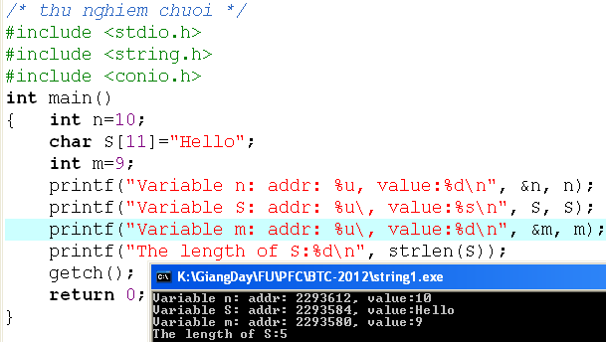
3- Gap: A safe method for string content.
Some compilers use a gap between variables to make a safety for strings.
2293612
10
28 bytes
Hello
Safe gap
2293584
2293580
9
If a so-long string is accepted, this string can overflow into the memory of the variable n

Slide 7
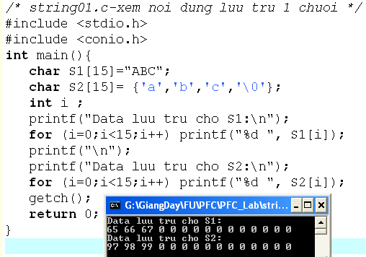
4- Data Stored in a strings
Each character in a string is stored as it’s ASCII code.
S1[i]: The character at the position i in the string S1

Slide 8
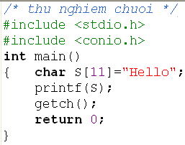
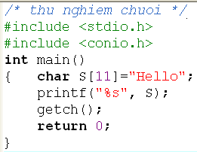
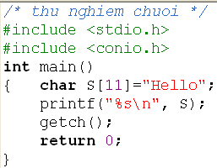
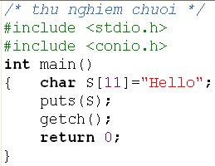
5- Output Strings – Test yourself
Observe the prompt symbol on the result screen .

Slide 9
6- Input Strings
Library: stdio.h
Function scanf() with type conversion %s
Function gets(string)
Each function has it’s own advantages and weaknesses.

Slide 10
Input Strings: scanf(…)
The %s conversion specifier
reads all characters until the first whitespace character,
stores the characters read in memory locations starting with the address passed to scanf,
Automatically stores the null byte in the memory byte following the last character accepted and
leaves the delimiting whitespace plus any subsequent characters in the input buffer → ignores any leading whitespace characters (default).
Option specifiers are used to change default characteristics of the function scanf on strings.

Slide 11
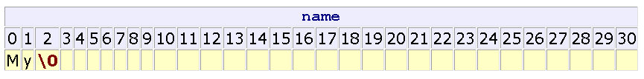
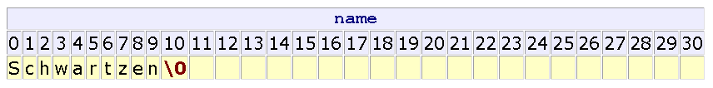
Input Strings: scanf(…)
char name[31];
scanf("%s", name );
Enter: My name is Arnold
Default
char name[31];
scanf(“%10s", name );
Enter: Schwartzenegger

Slide 12
Input Strings: scanf(…)
How to accept blanks in a input string?
%[^\n] conversion specifier
reads all characters until the newline ('\n'),
stores the characters read in memory locations starting with the address passed to scanf,
stores the null byte in the byte following that where scanf stored the last character and
leaves the delimiting character (here, '\n') in the input buffer.

Slide 13
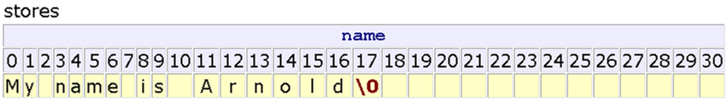
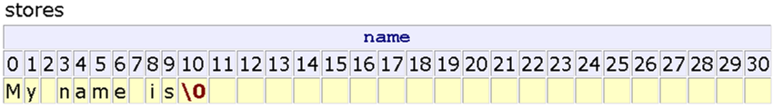
Input Strings: scanf(…)
How to accept blanks in a input string?
%[^\n] conversion specifier.

Slide 14
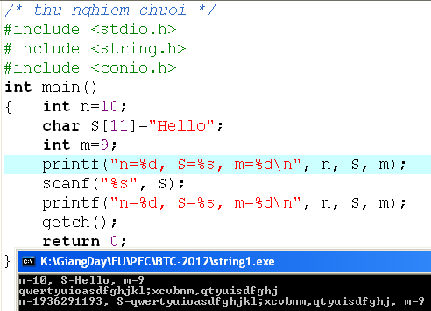
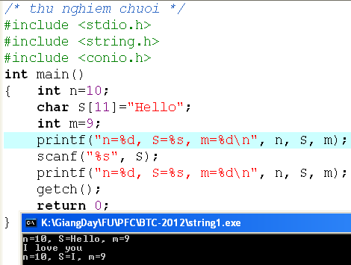
Input Strings: scanf(…) - Test
Why?
Why?
Replace:
scanf(“%s”, S) → scanf(“%10[^\n]”, S)

Slide 15
Input Strings: scanf(…)
Some character specifiers used in the function scanf(): Set of character are or not accepted.
Specifier | Description
%[abcd] | Searches the input field for any of the characters a, b, c, and d
%[^abcd] | Searches the input field for any characters except a, b, c, and d
%[0-9] | To catch all decimal digits
%[A-Z] | Catches all uppercase letters
%[0-9A-Za-z] | Catches all decimal digits and all letters
%[A-FT-Z] | Catches all uppercase letters from A to F and from T to Z

Slide 16
Input Strings: gets(…)
gets is a standard library function (stdio.h) that
accepts an empty string
uses the '\n' as the delimiter
throws away the delimiter after accepting the string
Automatically appends the null byte to the end of the set stored
The prototype for gets is char* gets(char [ ]); (gets is dangerous. It can fill beyond the memory that allocated for the string)

Slide 17
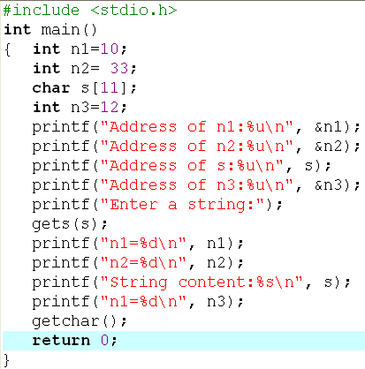
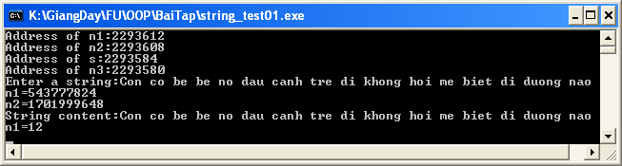
Input Strings: gets(…)
Overflow
2293612
n1: 10
2293608
n2: 33
s
2293584
2293580
12

Slide 18
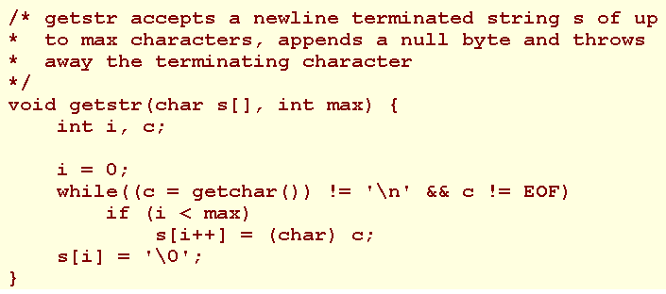
Input Strings: Do yourself a function for input s string

Slide 19

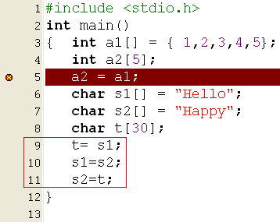

7- May Operators Applied to String?
C operators act on basic data type only.
➔ They can not be applied to static arrays and static strings.
We need functions for processing arrays and string

Slide 20
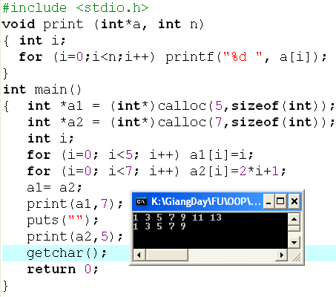
7- May Operators Applied to String?
The assign operator can act on pointers to dynamic array.
H
E
A
P
4
3
2
1
4030000
0
13
11
9
7
5
3
4010000
1
Stack
a1
4030000
a2
4010000
Assign Pointer: OK

Slide 21
7- Others String Functions: string.h
Purpose | Function
Get the length of a string | int strlen (char s[])
Copy source string to destination string | char* strcpy(char dest[], char src[])
Compare two strings | int strcmp( char s1[], char s2[]) → -1, 0, 1
Concatenate string src to the end of dest | char* strcat(char dest[], char src[])
Convert a string to uppercase | char* strupr(char s[])
Convert a string to lowercase | char* strlwr(char s[])
Find the address of a substring (Tìm chuỗi con trong chuỗi bự → Trả về giá trị của chuỗi con) | char* strstr (char src[], char subStr[]) NULL if subStr does not exist in the src. Strstr is pointer of src
Notes:
+ Thư viện <string.h>

Slide 22
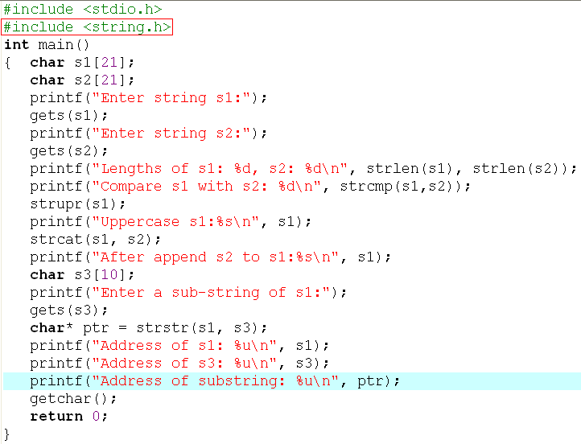
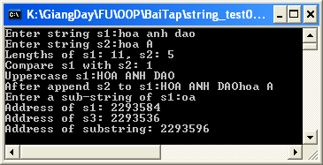
Others String Functions: string.h
HOA ANH DAOhoa A
2293584
2293596
strstr() → NULL if the substring doesn’t exist.

Slide 23
8- Some User-Defined String Functions
Purpose | Prototype
Trim blanks at the beginning of a string: “ Hello” → “Hello” | char* lTrim(char s[])
Trim blanks at the end of a string: “Hello ” → “Hello” | char* rTrim(char s[])
Trim extra blanks ins a string: “ I am student “ → “I am a student” | char* trim (char s[])
Convert a string to a name: “ hoang thi hoa “ → “Hoang Thi Hoa” | char* nameStr( char s[])

Slide 24
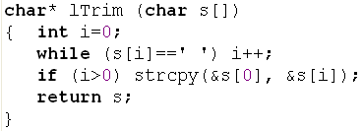
Some user-defined String Functions
0 | 1 | 2 | 3 | 4 | 5 | 6
 |  |  | H | o | a | NULL
i=0 | 1 | 2 | 3
0 | 1 | 2 | 3 | 4 | 5 | 6
H | o | a | NULL | o | a | NULL

Slide 25
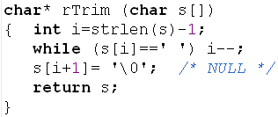
Some user-defined String Functions
0 | 1 | 2 | 3 | 4 | 5 | 6
H | o | a |  |  |  | NULL
 |  | 2 | 3 | 4 | i=5
0 | 1 | 2 | 3 | 4 | 5 | 6
H | o | a | NULL |  |  | NULL

Slide 26
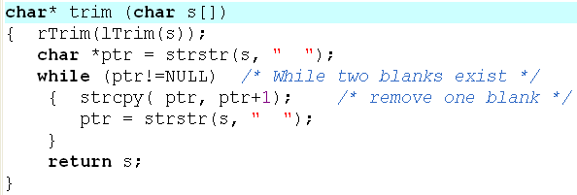
Some user-defined String Functions
“ Hoa anh dao “
“Hoa anh dao“
“Hoa anh dao“
lTrim
“Hoa anh dao“
“Hoa anh dao “
“Hoa anh dao“
rTrim
“Hoa anh dao“
“Hoa anh dao“
“Hoa anh dao“

Slide 27
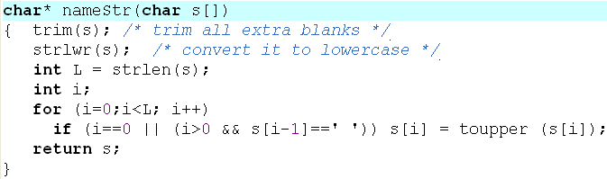
Some user-defined String Functions
“ hOA anH dAo nO “
trim()
“hOA anH dAo nO“
h | o | a |  | a | n | h |  | d | a | o |  | n | o
0 | 1 | 2 | 3 | 4 | 5 | 6 | 7 | 8 | 9 | 10 | 11 | 12 | 13
strlwr()
“hoa anh dao no“
“Hoa Anh Dao No“

Slide 28
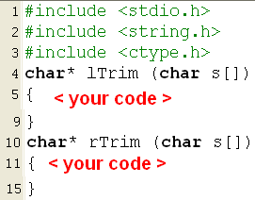
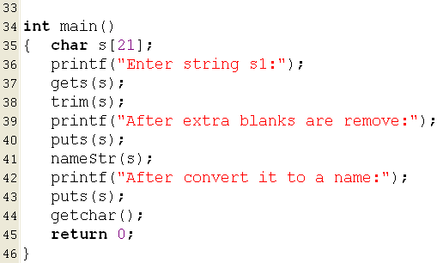


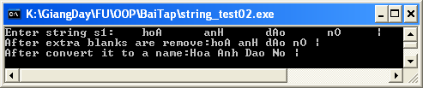
Some user-defined String Functions

Slide 29
Some user-defined String Functions
Suppose that only the blank character is used to separate words in a sentence. Implement a function for counting number of words in a sentence.
T |  | n | u |  |  | n | a |  | n | u |  |  | n | o | n | g |  |  | t
0 | 1 | 2 | 3 | 4 | 5 | 6 | 7 | 8 | 9 | 10 | 11 | 12 | 13 | 14 | 15 | 16 | 17 | 18 | 19
i
count
0
1
2
3
4
5
6
Counting words in a string
Do Yourself
Criteria for increasing count:
- s[i] is not a blank and (i==0 or s[i-1] is a blank)

Slide 30
Some user-defined String Functions
Counting integers in a string
1 | 2 | n | u | a | 7 | n | a | 9 | d | f | 1 | 2 | 3 | 4 | 5 | 9 | P | 7
0 | 1 | 2 | 3 | 4 | 5 | 6 | 7 | 8 | 9 | 10 | 11 | 12 | 13 | 14 | 15 | 16 | 17 | 18 | 19
i
count
0
1
2
3
4
5
Do Yourself
Criteria for increasing count:
- s[i] is a digit and (i==0 or s[i-1] is not a digit)

Slide 31
Some user-defined String Functions
Replace all existences of a sub-string (subStr) in a string (source) by another (repStr)
subStr: “coc”, subL=3
source
ptr= strstr(source, subStr)
repStr: “bo”, repL=2
c | o | n |  | c | o | c |  | t | r | o | n | g |  | h | a | n | g
The function strcpy will copy char-by-char from the left to the right of the source to the destination. So, it will work properly when a sub-string is shifted up only.
strcpy(ptr, ptr+subL)
c | o | n |  |  | t | r | o | n | g |  | h | a | n | g
strcpy(temp, ptr)
 | t | r | o | n | g |  | h | a | n | g
strcpy(ptr+repL, temp)
c | o | n |  |  | t |  | t | r | o | n | g |  | h | a | n | g
A temporary string is used when a sub-string is shifted down.
repStr
b | o | \0
for (i=0; i<repL, i++) *(ptr+i) = repStr[i];

Slide 32
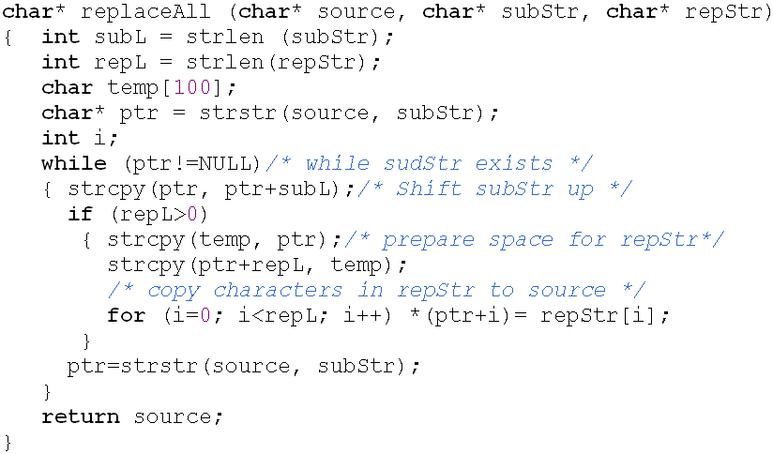
Some user-defined String Functions
Replace all existences of a sub-string (subStr) in a string (source) by another (repStr)

Slide 33
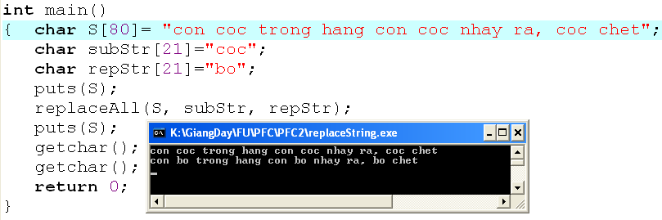
Some user-defined String Functions
Replace all existences of a sub-string (subStr) in a string (source) by another (repStr)

Slide 34
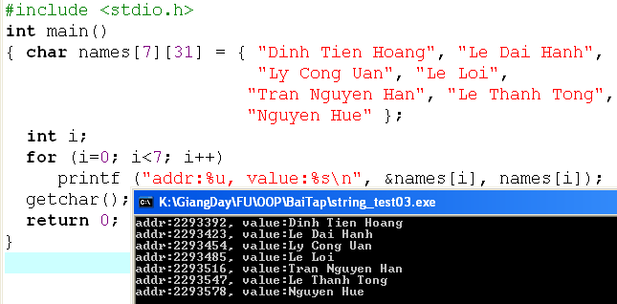
5- Array of Strings
Declaration: char identifier [numberOfString][number_byte_per_string];
Initialization:
Dinh Tien Hoang
Le Dai Hanh
Ly Cong Uan
Le Loi
Tran Nguyen Han
Le Thanh Tong
Nguyen Hue

Slide 35
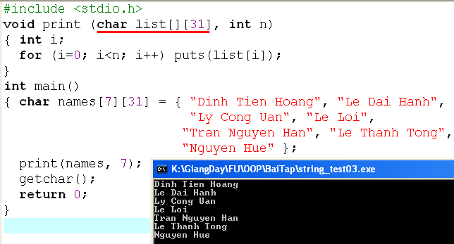
Array of Strings…
Parameter in a function

Slide 36

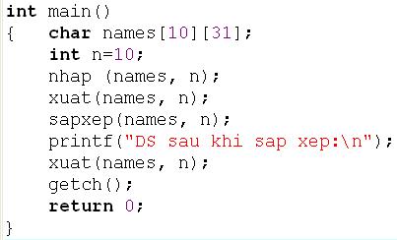
Demo: Array of Names
Write a C program that will accept 10 names, print out the list, sort the list using ascending order, print out the result.

Slide 37
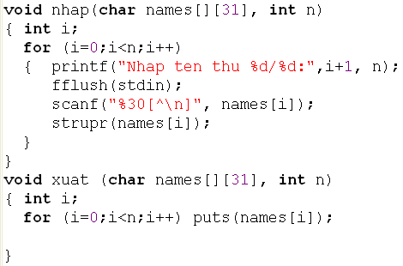
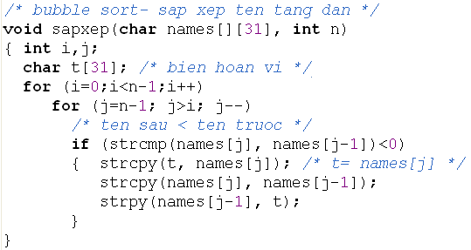
Demo: Array of Names

Slide 38
Summary
String in C is terminated by the NULL character (‘\0’)
A string is similar to an array of characters.
All input functions for string will automatically add the NULL character after the content of the string.
C-operators will operate on simple data types ➔ Function on arrays, strings are implemented to operate on arrays and strings
If dynamic arrays or strings (using pointers), the assignment can be used on these pointers.

Slide 39
Summary
String Input
scanf
gets
Do yourself using getchar()
String Functions and Arrays of Strings
Functions
strlen
strcpy
strcmp
strcat
strstr
Arrays of Strings
Input and Output
Passing to Functions
Sorting an Array of Names
Q&A

Slide 40
Slot 24- Exercise
Write a C-program that helps user managing a list of 100 student names using the following menu:
1- Add a student
2- Remove a student
3- Search a student
4- Print the list in ascending order
5- Quit

Slide 41
Thank You

Slide 42
BT1: Nhập vào 1 chuỗi, đếm số lần xuất hiện của từng kí tự trong chuỗi
BT2: Nhập 1c, ktra chuỗi có đối xứng k
BT3: nhập s1,s2. Ktra s2 có phải chuỗi con của s1 k, nếu có thì bn lần
BT4: Nhập vào chuỗi str, chèn strinsert vào str tại vt.

